Slide 1
AS91883(1.7) & AS91884(1.8) Documentation
EJ

Slide 2
[Overtype this with your program name]
Link to GitHub Repository: https://github.com/EJYourstruely/Lucky-unicorn
Links to Trello board / project management tools: https://trello.com/b/7OowAhFt/lucky-unicorn
Link to final version of your program: [here]
Ensure you have made these links ‘public’ so that they are open to anyone, including the marker. The link to your program is the final outcome of this whole project – your finished program.

Slide 3
Describe relevant Implications:
Additional rows can be added by clicking in the last cell and then using the Tab key
Relevant implication | Describe the implication and give an example
Functionality | Functionality is about ensuring that the program works as expected. It should work for expected, boundary and unexpected cases. For example, if my program asks how many rounds a user wants, it should work for expected input like '2' or boundary input like '1' but it should not crash if the user enters something invalid like 'O' or '0.5' or 'one'
Usability | Usability is about how easily the end user can get the program to do what it is supposed to do. It deals with issues like making instructions and error messages clear and easy for users to understand. It is important to minimise or eliminate any frustration.
Aesthetics | Aesthetics is about the program's overall appearance. A program which looks good because it includes well spaced instructions, prompts and 'decoration' around key messages is going to be more aesthetically pleasing than one which is composed of unspaced plain text.
Notes:
Additional rows can be added by clicking in the last cell and then using the Tab key

Slide 4
Describe relevant Implications:2
Additional rows can be added by clicking in the last cell and then using the Tab key
Relevant implication | Describe the implication and give an example
Social | The social implications of a computer program are about the affect it might have on users, the wider community, and society as a whole. For example, computer programs which are based around a gambling game can have a negative impact on society if there are no safeguards in place to limit users from excessive losses. It is also important to use clear, unambiguous instructions and feedback which is culturally neutral and inoffensive.
Future proofing | Future-proofing is about making a program which is flexible and adaptable and easy to modify later if necessary. The code needs to be well set out and commented on so that another programmer can make changes easily at some future time. Someone who wants to modify my code in the future needs to understand the purpose and reasoning behind different parts of the code. Also, it’s important to use constants rather than literals - to minimize the number of places where changes have to be made.
Notes:
Additional rows can be added by clicking in the last cell and then using the Tab key

Slide 5
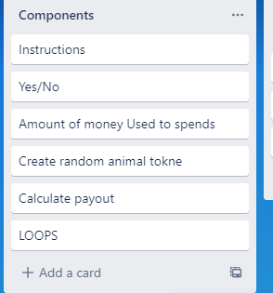
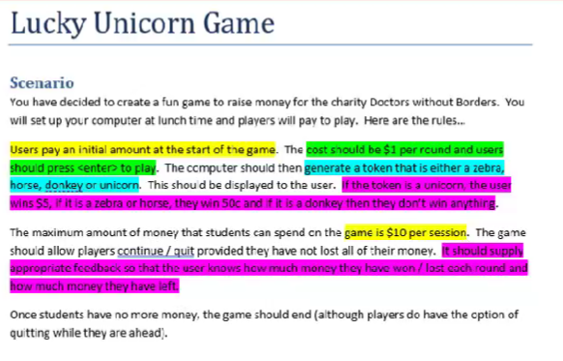
Decomposition:
Notes:
Paste screenshots of your initial Trello board / task decomposition on this slide. If you have a long list, you might need to break it up into several slides.

Slide 6
[Yes/no checker - Test Plan
Additional rows can be added by clicking in the last cell and then using the Tab key
Test Cases - input | Expected output
Yes | Program continues
y | Program continues
no | Program continues
n | Program continues
yes | Program continues
maybe | Please enter yes or no
Notes:
Additional rows can be added by clicking in the last cell and then using the Tab key

Slide 7
[Instructions] - Test Plan
Additional rows can be added by clicking in the last cell and then using the Tab key
Test Cases - input | Expected output
Have you played before? Maybe | Error please choose y/n
Have you played before? Yes | Game start
Have you played before? no | Show instructions
Notes:
Additional rows can be added by clicking in the last cell and then using the Tab key

Slide 8
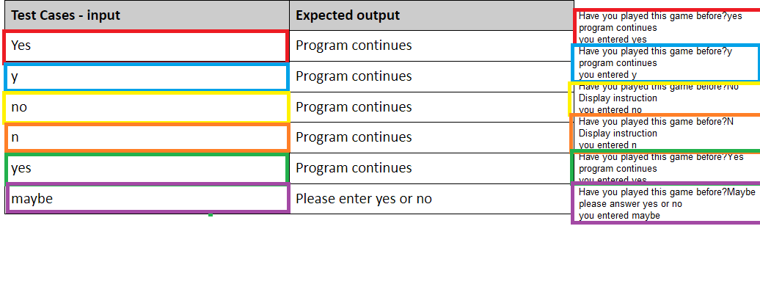
[Yes/No]: Testing
Notes:
You must show the results of testing. For each component, include a screenshot proving it works. You can also include notes about each test.

Slide 9

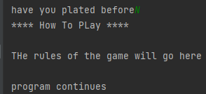
Yes/no :Trialing
Additional rows can be added by clicking in the last cell and then using the Tab key
Test Cases - input | Expected output
Have you played before? Maybe | "please enter yes or no" Have you played before
Have you played before? Yes | Game starts
Have you played before? No | Show instruction starts game
Notes:
Additional rows can be added by clicking in the last cell and then using the Tab key

Slide 10
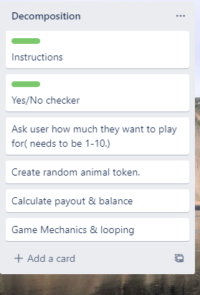
Component 2 How much

Slide 11
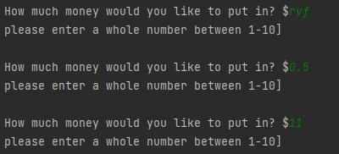


How much: Test Plan
Additional rows can be added by clicking in the last cell and then using the Tab key
Test Cases - input | Expected output
Xxii (invalid-string) | <error> Please enter a whole number between 1-10
0.5(Invalid-float) | <error>Please enter a whole number between 1-10
11(invalid-too high) | <error>Please enter a whole number between 1-10
1(valid- low boundary | Program continues
10(valid- upper boundary | Program continues
Notes:
Additional rows can be added by clicking in the last cell and then using the Tab key

Slide 12
How much: Trialing
Additional rows can be added by clicking in the last cell and then using the Tab key
Test Cases - input | Expected output
Trial 1 04_how_much_v1 | Program works but only if the user enters integers. It correctly refuses integers outside the required range but crashes when invalid (string/float) data is entered
Trial 2 04_how_much_v1 | Program responds appropriately to invalid by refusing it without crashing and offering the user an opportunity to try again. However, the code is quite long and could be made more efficient.
Trial 3 04_how_much_v1 | In this 3rd trial I included the valid range (1-10) as the basis of the while loop which eliminated the need to use the 'valid' variable. The result is more efficient yet every bit as adaptable for recycling as Trial 2.
Trial 4 04_how_much_v1 | Changed v3 into a function. Made user_balance a more generic variable name 'response' and changed the condition and position of the number comparison into the loop to make the function recyclable. I will adopt this one in my final program
Notes:
Additional rows can be added by clicking in the last cell and then using the Tab key

Slide 13
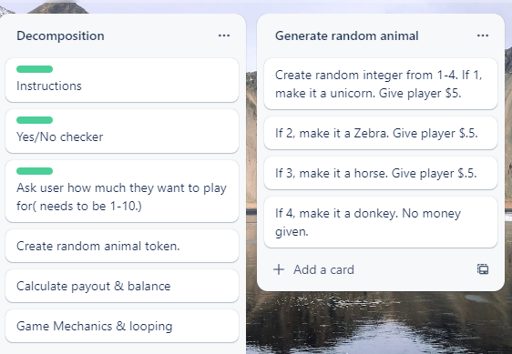
Component 3 (generate random token)
﻿ The pay-out schedule is: •Donkey: lose $1.00 •Horse/Zebra: lose $0.50
Unicorn: win $4.00
(i.e. if user starts with $1 and gets a Unicorn, their balance will be $5.00)
In this component we need to check that over time the user loses money to make the game viable.

Slide 14
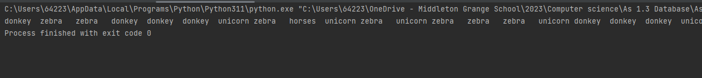
Test Plan: Tokens randomly generated
Test Case-Input | Expected out put
Run the outcome | Program should output 20 tokens with at least one each of: horse,donkey, zebra and unicorn. The order of the token must be random

Slide 15
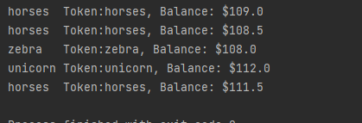

Tokens randomly generated: testing
Testing on right (Trial 2) shows results for 100 rounds: 10% chance of a unicorn 30% chance for each of donkey, zebra and horse
﻿ Testing on right (Trial 3) shows results for only 10 rounds: 5% chance of a unicorn 30% chance of a donkey 65% chance of each of zebra or horse. The house advantage becomes clearer if we run the program for more than 100 rounds:

Slide 16
Yes/no :Trialing
Additional rows can be added by clicking in the last cell and then using the Tab key
Test Cases - input | Expected output
Trial 1 05_token_generator_v2 | ﻿This program chooses from a list of 'horse', 'unicorn', 'donkey' and 'zebra'. When run 100 times, it became clear that the house would lose money instead of making it.
Trial 2 05_token_generator_v3 | In this trial I changed the list so that there were 10% unicorns and 30% of each of the others (1 unicorn and 3 each of the others). This did give the house an advantage.
Trial 3 05_token_generator_v4 | In my third trial, instead of choosing items from a list, I chose a random integer between 1 and 100. The schedule was set up so that users had a 5% chance of getting a unicorn, a 30% chance of getting a donkey and a 65% chance of getting a horse or zebra. For this last 65% it awarded horse or zebra depending whether or not the number generated was even (horse) or odd (zebra)
Notes:
Additional rows can be added by clicking in the last cell and then using the Tab key

Slide 17
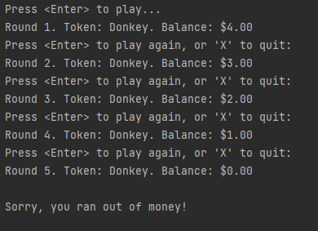
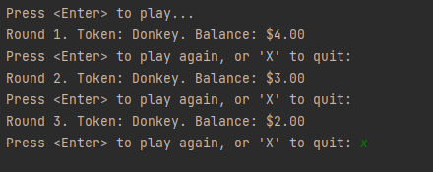
Test Plan: Tokens randomly generated
Test Case-Input | Expected out put
User starts with $5 User continues playing until the money runs out | Game should go for 5 rounds. Each round should be correctly numbered After 5 rounds, it should display 'Sorry you have run out of money'
Starting amount $5 User plays 3 rounds and then exits | Game should go for 3 rounds When user enters 'X' the game should end Final balance should be $2

Slide 18
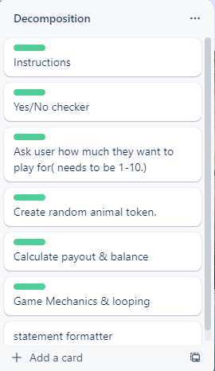
Statement formatter
I realized that we often need to make output stand out and creating a function to help to do this is a good idea. This component was added to the decomposition near the end of the development process.

Slide 19



How much: Test Plan
Additional rows can be added by clicking in the last cell and then using the Tab key
Test Cases - input | Expected output
Statement 1 Welcome to lucky unicorn game decoration
Statement 2 Congrats you got a unicorn
Statement 3 Goodbye
Notes:
Additional rows can be added by clicking in the last cell and then using the Tab key

Slide 20
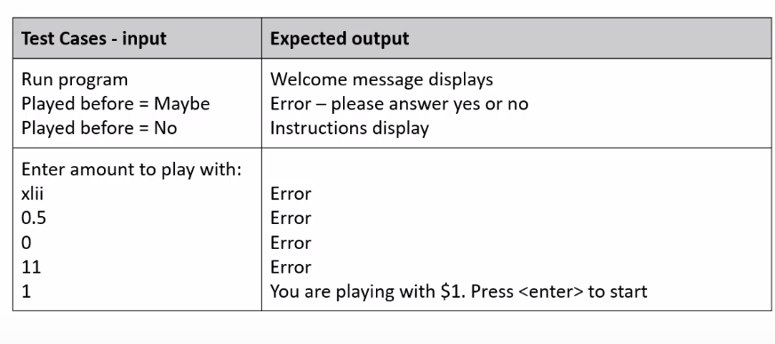
Test Plan: Assembled Outcome

Slide 21
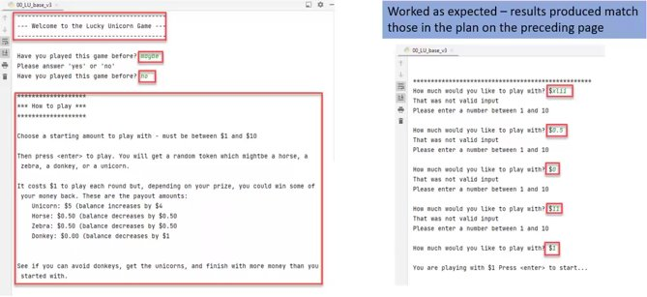
Assembled outcome testing

Slide 22
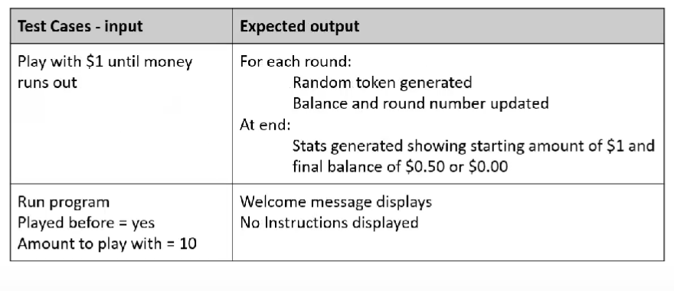
Test Plan: Assembled Outcome 2

Slide 23
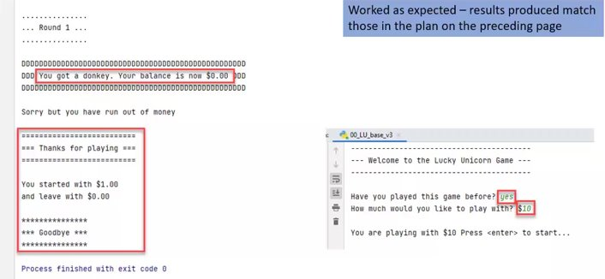
Assembled outcome testing 2

Slide 24
Test Plan: Assembled Outcome 3

Slide 25
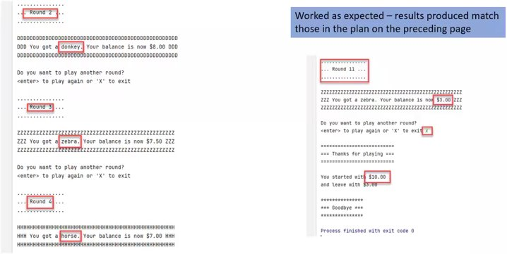
Assembled outcome testing 2

Slide 26
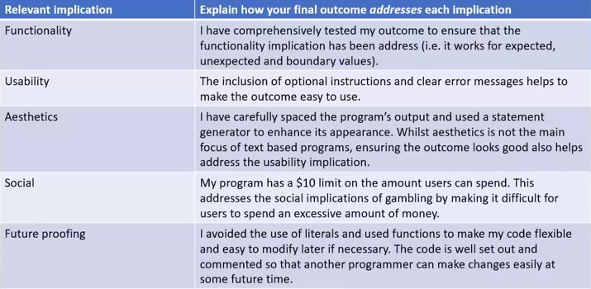
Address relevant Implications:

Slide 27
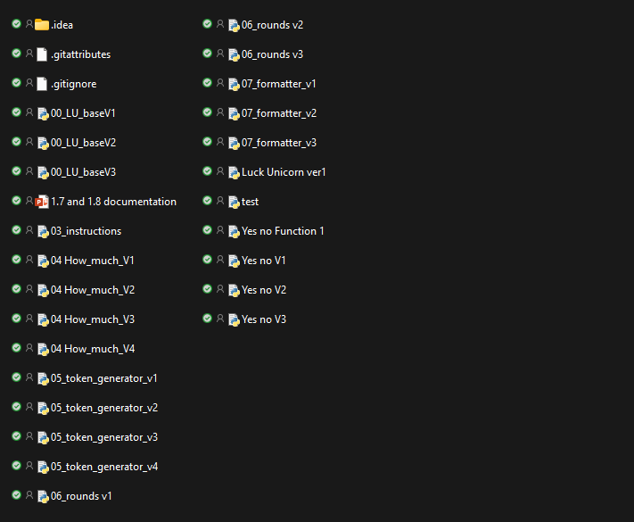
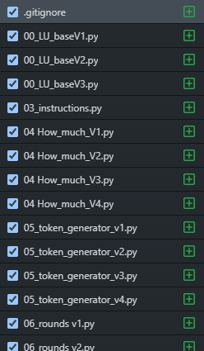
Version Control Evidence:
Your version control evidence should go here. This could be in the form of screenshots (both of your GitHub repository as well as your local project folder) as evidence of your incremental development.
Notes:
Your version control evidence should go here. This could be in the form of screenshots (both of your GitHub repository as well as your local project folder) as evidence of your incremental development.

Slide 28
Final Discussion:
Final Discussion:
Discuss how the information from planning, testing and trialling of components assisted in the development of a high-quality outcome.
While developing this program, I planned, tested and trialed its individual components and then later as a whole working game.
By decomposing the problem, I could plan my program efficiently and focus on creating and testing small chunks of code. Each of these chunks was thoroughly tested during and after construction.
By testing, I was able to find and fix the flaws in my program before combining them into the full program.
Having volunteers test my program enabled me to further improve its functionality and get ideas about how to improve it, which raised the finished program's reliability and quality.
User feedback enabled me to look at the program from a non-programmer's point of view. This, combined with the information I got from the earlier planning, testing, and trialling, enabled me to produce a high-quality outcome.
I tested my code using http://pep8online.com/ to make sure that it met the conventions regarding spacing and layout (see the next slide)
Notes:
Discuss how the information from planning, testing and trialling of components assisted in the development of a high-quality outcome.

